Slide 1
Hackathon
Challenge :- 21st Centaury Education
Team Name:- (Beat The Challenge)
Team Member:-Lucky Borana
Contact:- luckyborana97@gmail.com
Contact No:- +91-9636214651

Slide 2
Free Education with Technolgy Advancement
Points To Cover
Problem Facing
HTD(How To Do)
Low Cost Coverage with Advancement
Note:- My English is not better but you able to understand.

Slide 3
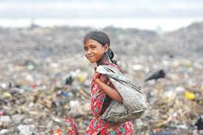
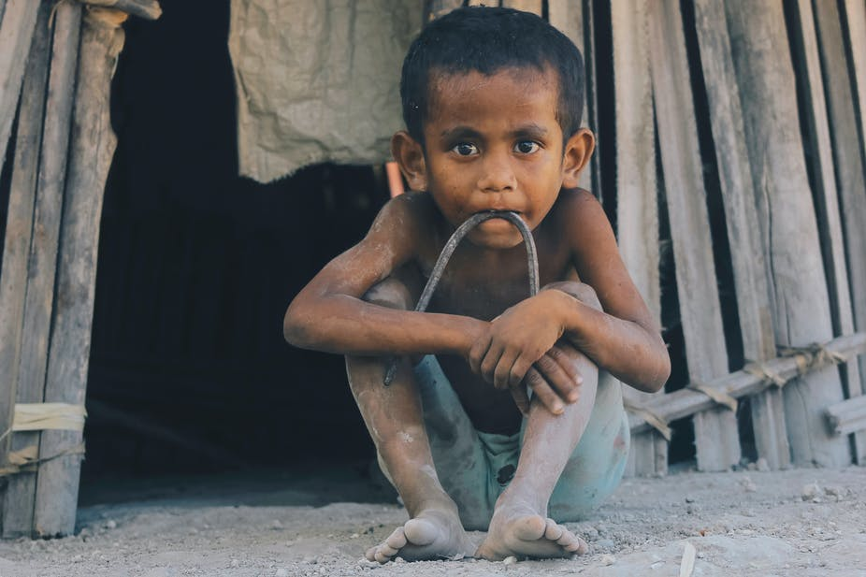
Problem Facing
Now time poorer are going more poor. And richer are going more rich.
And this education are going more and more costly this time. Am talking private education cost. But the government education going down and down.
Poor people don’t have enough money to educate there child for food the final option going to or to do work or beg that is most worst word I think.
If any child want to educate then there also difficult to do because family thinks we don’t have money its better to work for the food.
Here we noticed that word money and education comes more n more times.

Slide 4
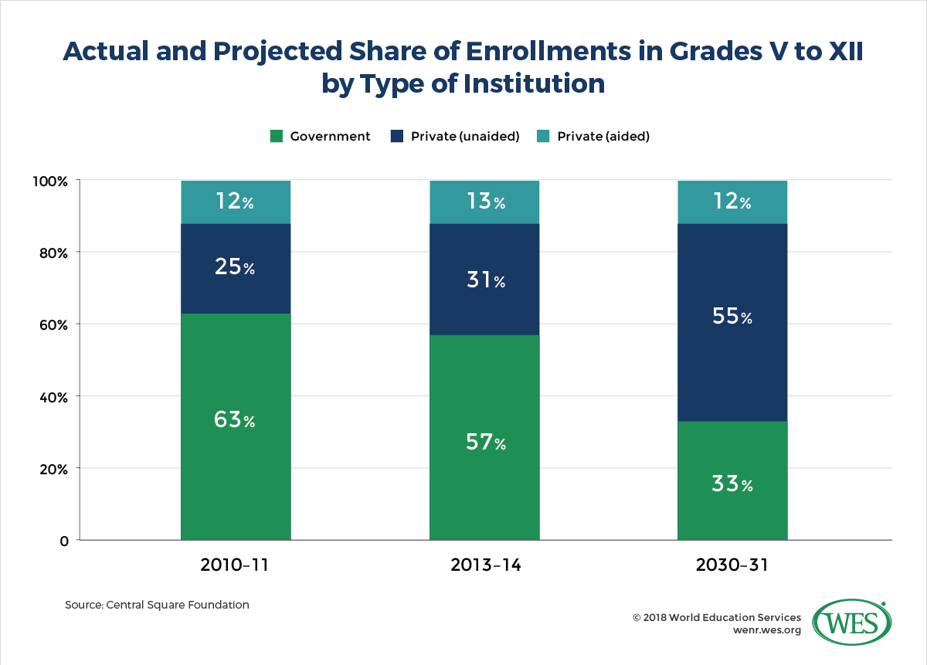
Government distribution of knowledge going down day to day.

Slide 5
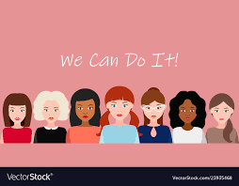
Here Comes How We Can Do it

Slide 6
HTD(How To Do)
We do with combine and work together with government and technology advancement.
Here it is very simple but little help from Government.

Slide 7
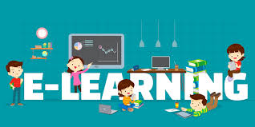
Now times Government should do convert there school into labs so by the help of tablets and computer with attachment of internet and headphones.
By free E-learning and pre recorded session . Wait wait for the idea it will reveal soon at down.

Slide 8
NOW IDEA IS
We do teach via in E-learning in labs .
Via E-learning we use our internet or tablet.
The child register with his/her aadhar card.
But that web app and application connected with technology blockchain.
By via e-learning we give task to children if he/she do if task completed we gives reward or cash price to child or his family bank account.

Slide 9
In web or application they also contains ads and survey for that survey also we do give he/she reward to them.
But the survey and ads contains logic ads
And also openly declare compition and by this India becomes educated and more then more best peopled comes up by open mind we can connect them .
The education we open and free class up to secondary education (Till 10th).

Slide 10

By this we also by ads and from survey what we earn by online we distribute the children.
And second main part is less teachers can save money and that money directly share to chid .
Here how we educate poor people.
WE greed to child to learn more and earn by digitally.
There also more steps to follow.

Slide 11
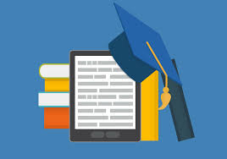
By digitally they can Earn by Learn

Slide 12
My main Moto:- EARN BY LEARN

Slide 13
Low Cost Coverage with Advancement
Here one time investment learning child more then more
As we also know how government teachers are now time.
By this teacher will less so we can conserve money of government and that money goes to child.

Slide 14
Technology We To Develop
We want to make app and tablet .
In tablet there is only app can run and nothing can do by tablet.
If child complete task or exam he will get reward in directly in bank.
So by this we can make out indian future better then better before.
There are also more to discuss but for that I cant declare openly.

Slide 15

Note:- This Idea Copy Rights Completely Belong To team member (Lucky Borana(Beat The Challenge))

